Slide 1
Lecture ​​1.2 - What is Data Science?
DLI Accelerated Data Science Teaching Kit

Slide 2

The Accelerated Data Science Teaching Kit is licensed by NVIDIA, Georgia Institute of Technology, and Prairie View A&M University under the
Creative Commons Attribution-NonCommercial 4.0 International License.

Slide 3
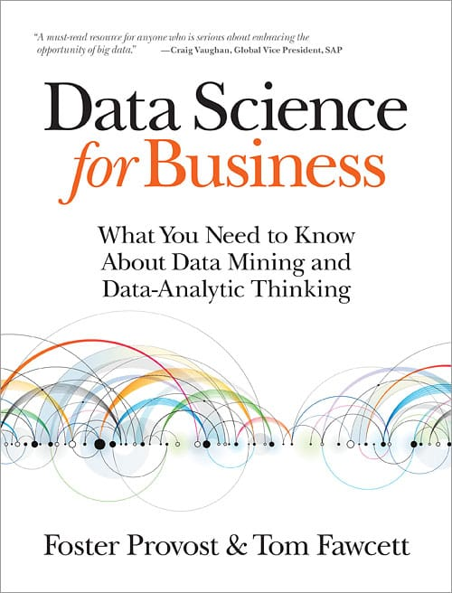
What is Data Science?
“At a high level, data science is a set of fundamental principles that guide the extraction of knowledge from data.”
Principles can be statistical, computational, algorithmic, visual, etc.

Slide 4
What is Data Science? In more detail…
Relatively young field
The term often broadly used, due to its hype
“Definition” (e.g., what it is, what it includes) often hotly debated; a controversial topic! (https://en.wikipedia.org/wiki/Data_science)
Related to statistics, computer science, visualization, data mining, machine learning, human-computer interaction, big data, distributed computing, and more!

Slide 5
What is Data Science? Why so complex?
Data science is interdisciplinary, due to its goal to aid discoveries, decision making, etc.
Applicable to many domains (e.g., sciences, finance, healthcare, etc.)
Often requires analysis of large amount of data (helpful to use scalable algorithms, distributed computing, etc.)
Statistics is a pillar of data science
Users may need to explore data, and understand and present analysis results (benefits from visualization, good user interface design, etc.)
And more!

Slide 6
DLI Accelerated Data Science Teaching Kit
Thank You

